Slide 1
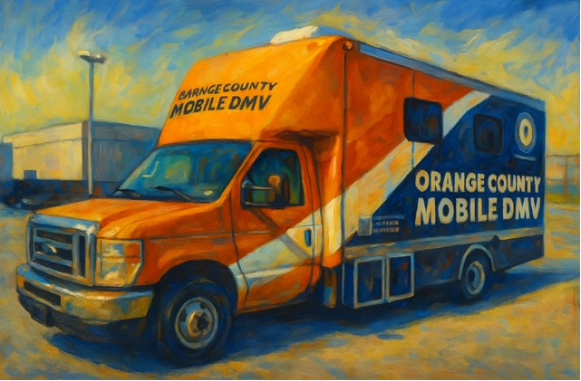

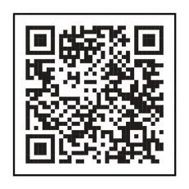
ORANGE COUNTY CLERK KELLY A. ESKEW
INVITES YOU TO THE
ORANGE COUNTY MOBILE DMV OFFICE
Wednesday August 19, 2026
Village of Walden Wooster Grove Park
89 East Main Street
Walden NY 12586
Hours:
10:00am - 12:00pm
(Closed 12:00pm - 1:00pm)
1:00pm - 3:30pm
Transactions Offered at the Mobile DMV Office:
All Registration transactions
All License transactions including REAL/Enhanced ID
Enforcement transactions
Please visit dmv.ny.gov for all necessary original documents needed before your visit to the Mobile DMV. Expect some delay due to the high volume of customers applying for the REAL or Enhanced ID.

